Slide 1
“Sales Data Analysis”
By
Hemant Gupta
Email- hemantgupta0801@gmail.com
LinkedIn- https://www.linkedin.com/in/hemant-gupta-4914baa6

Slide 2
Overview
In this project, I analyze a large dataset available in the form of a CSV file. The analysis focuses on various parameters related to sales, including:
Monthly Sales Trend: Month wise revenue collection sales analysis.
Top/Bottom 10 Revenue from Country: Analysis of Revenue by top 10 and bottom 10 countries and locations.
Average Spend Per Customer: Calculate the Avg spend per customer for analysis by using DAX function.
Slicers for Filtering Data: Tools for filtering data based on Country, Year and Month Name to crate an interactive and for more specific dashboard.
Total Revenue, Total Quantity Sold, Total Transaction and Unique Customer:- Analyze the data based on total revenue, total quantity, unique customer and total unit sold in the multi row card visuals.
To achieve these objectives, I utilize various types of visualizations in Power BI, such as:
Slicers
Map Visuals
Line Chart
Multi-Row Card Visual
Matrix Chart
Bar Chart

Slide 3
Steps Taken to Analyze the Sales Data
Understanding the Problem:
The task involves analyzing the restaurant data based on various parameters to retrieve actionable insights from the dataset.
Data Collection:
Collected raw data in the form of a CSV file.
Imported the data into Power BI Desktop using the 'Get Data' option.
Transformed the data in the Power Query Editor for the data cleaning process.
Data Cleaning:
The raw data contained issues such as null values, check data type, duplicate entries, and blank data fields.
Performed data cleaning in the Power Query Editor.
Loaded the cleaned data into Power BI Desktop to create visuals based on the specified parameters.
Data Analysis:
Created various visualizations, including Column, Map Visuals, Line Charts, Multi Row Card Visuals and Matrix Charts, to
analyze the data.
Identified trends and extracted insights from the visualized data on the dashboard.
Interpreting Results:
Derived insights from the dashboard.
Compiled a final report detailing the data analysis findings.

Slide 4
“DAX Function” Used in Sales Data Analysis
Avg Spend per Customer = DIVIDE([Total Revenue], [Unique Customers], 0)
Total_Revenue = SUMX(Sales_Data, Sales_Data[Quantity] * Sales_Data[UnitPrice])
Unique Customers = DISTINCTCOUNT(Sales_Data[CustomerID])

Slide 5
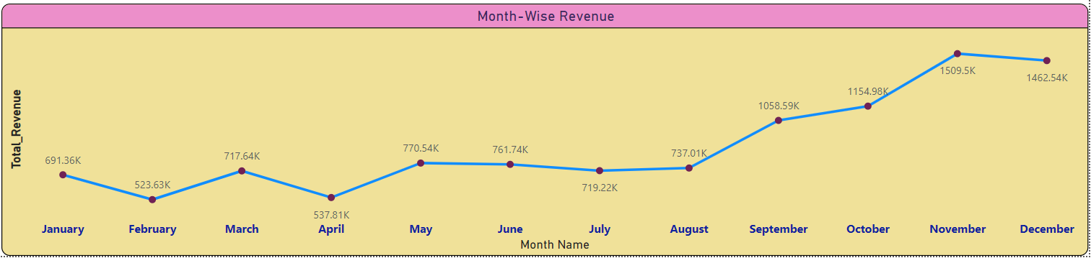
Month- Wise Revenue Analysis
Visualization Type: Line Chart
Insights:- The line chart displays the monthly revenue, with December having the highest revenue at ₹1,462.54K and February the lowest at ₹523.63K.
:- There is a noticeable increase in revenue in the months of November and December, indicating strong seasonal sales, likely due to winter holiday shopping.

Slide 6
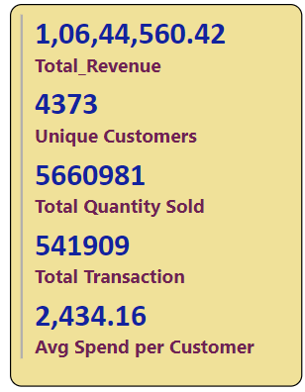
Total Revenue, Total Quantity Sold, Total Transaction and Unique Customer
Multi Row Card
Insights:-
Total Revenue:
The total revenue is displayed as ₹10,64,4560.42.
Unique Customers:
There are 4,373 unique customers.
Total Quantity Sold:
A total of 5,660,981 units were sold.
Total Transactions:
There were 541,909 transactions.
Average Spend per Customer:
The average spend per customer is ₹2,434.16.

Slide 7
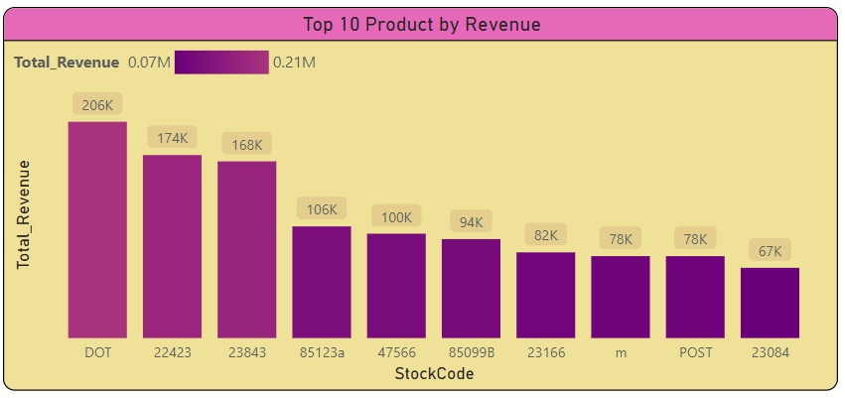
Top 10 Products by Revenue
Visualization Type:- Column Chart
Insights:-
The bar chart shows the top 10 products by revenue. The highest revenue-generating product has a Stock Code of DOT with approximately ₹206K in revenue.
A few products dominate the sales, with the top product generating over ₹2.1M in revenue.

Slide 8
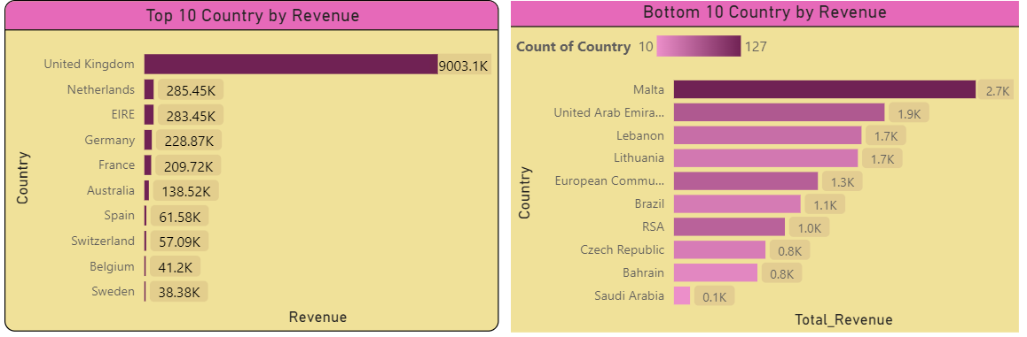
Top 10 and Bottom 10 Country by Revenue
Visualization Type:- Bar Chart
Insights:-
Top 10 Countries by Revenue:
The bar chart shows the top 10 countries by revenue. The United Kingdom leads significantly with ₹9,003.1K in revenue.
Other countries in the top 10 include Netherlands, EIRE, Germany, and France.
Bottom 10 Countries by Revenue:
The bar chart displays the bottom 10 countries by revenue. Malta is the highest among the bottom 10 with ₹2.7K in revenue.

Slide 9
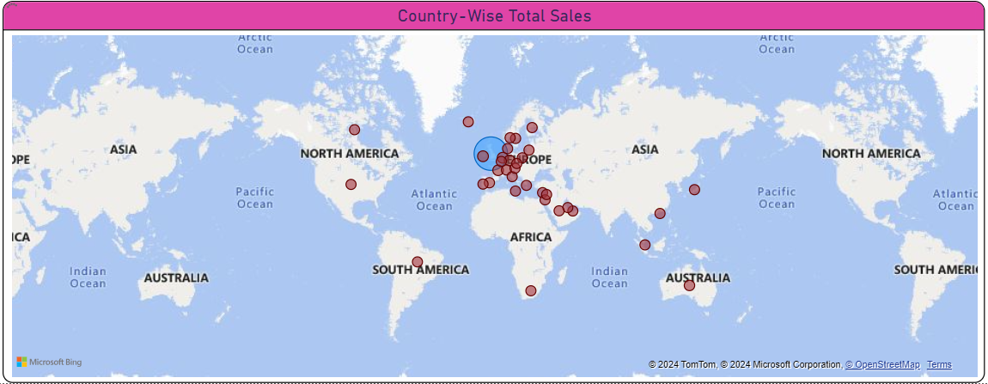
Theme-Based vs Non-Theme-Based Restaurants
Visualization Type:- Map Visuals
Insights:- Sales are heavily concentrated in certain countries, with some countries showing very low revenue, indicating potential markets for growth.
This map shows the geographic distribution of restaurants.

Slide 10
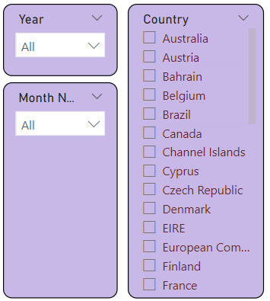
Slicers (Filters) by Location and Restaurant Category
Insights:- To enhance the data analysis process, I utilized slicers in Power BI. Specifically, I implemented slicers based on ‘Country Location’, Month Name and Year. These slicers provide the following benefits:
Enhanced Specificity: Allows for more granular analysis by filtering data according to specific city locations and restaurant categories.
Improved Interactivity: Adds value to the dashboard by making it interactive, enabling users to explore the data dynamically.
Efficient Data Analysis: Facilitates a more targeted examination of the dataset, helping to uncover detailed insights and trends.
Using slicers, the dashboard becomes a powerful tool for understanding and interpreting the restaurant data in a more meaningful way.

Slide 11
Insights and Recommendations Insights: High Revenue from the UK: The United Kingdom is the major revenue contributor, generating significantly more revenue than other countries. Product Performance: A few products dominate the sales, with the top product generating over ₹2.1M in revenue. Seasonal Trends: There is a noticeable increase in revenue in the months of November and December, indicating strong seasonal sales, likely due to holiday shopping. Customer Spending: On average, each customer spends ₹2,434.16, which is useful for understanding customer behavior and potential customer value. Geographical Distribution: Sales are heavily concentrated in certain countries, with some countries showing very low revenue, indicating potential markets for growth. Recommendations: Focus on High-Performing Countries: Continue to focus marketing and sales efforts on high-performing countries like the United Kingdom, Netherlands, EIRE, and Germany. Promote During High Revenue Months: Capitalize on the high-revenue months (November and December) by running special promotions and discounts. Expand in Low Revenue Countries: Investigate the reasons for low sales in the bottom-performing countries and develop strategies to increase market penetration and revenue. Enhance Product Portfolio: Analyze why top products are performing well and consider expanding the product line with similar items to boost overall revenue. Customer Retention: Implement loyalty programs and targeted marketing campaigns to increase the average spend per customer and retain valuable customers.

Slide 12
Thank You

